Slide 1
Looks Good To Me:
Visualizations As Sanity Checks
Written By: Michael Correll, Mingwei Li,
Gordon Kindlmann, and Carlos Scheidegger
Presented By: Shilpi

Slide 2

OBJECTIVE
Introduction
Visualization Of Distribution
Terms
Flaw Types
Validity
Results
Conclusion

Slide 3
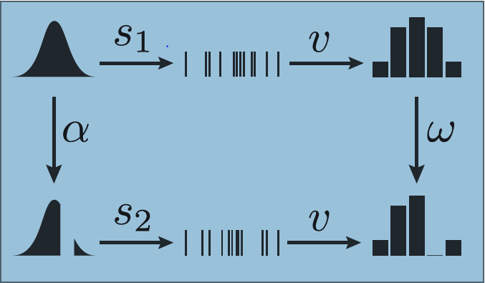
INTRODUCTION
Validating how much we can trust visualization for sanity check
Study in terms of Kindlmann and Scheidegger’s Algebraic Visualization Design (AVD)
A change in the dataset, depicted as a transformation α : D → D in data space,
is paired via the visual encoding with precisely one transformation in image space ω : V → V
Focus is on visualization of univariate distribution
Validating most popular visualizations – Histogram, Density Plot & Dot Plot

Slide 4
VISUALIZATIONS OF DISTRIBUTIONS

Slide 5
HISTOGRAM
It is often use for Data preparation and summarization.
Count Data occurrences in discrete bins.
Design Parameter
Size
Location Of bin
Too many bins produce sparse or noisy counts that obscure the overall distribution shape.
Too few bins result in loss of spatial modes or trends.

Slide 6
DENSITY PLOTS
It use KDE to create smooth curve based on the observed data.
Kernel density estimation is a non-parametric way to estimate the probability
density function of a random variable. Kernel density estimation is a
fundamental data smoothing problem where inferences about the population are
made, based on a finite data sample.
Design Parameter
Bandwidth of the kernels
Too large Bandwidth --- over-smooth the visualization
Too small Bandwidth --- under-smooth the visualization

Slide 7
DOT PLOTS
Encode each sample of distribution as a dot. This is considered as a special 1-D case of scatterplots.
Design Parameter
Opacity of the marks.
Too much opacity --- modes and the shape of distribution become invisible with over plotting.
Too little opacity --- outliers and smaller structures are impossible to see.

Slide 8
TERMS

Slide 9
CONFUSER
HALLUCINATION
A change in data α that does not change the visualization output ( that is, whose
corresponding ω is the identity ) is termed as CONFUSER
Confusers identify ambiguities in visual mappings by capturing differences in the data that are invisible to the viewer.
If a visualization produce different outputs because of the order in which elements are stored in a list, then switch from one representation to another is
a HALLUCINATOR
It is awy to “trick” the visualization into producing an apparent change where there should be none.

Slide 10
FLAW TYPES

Slide 11
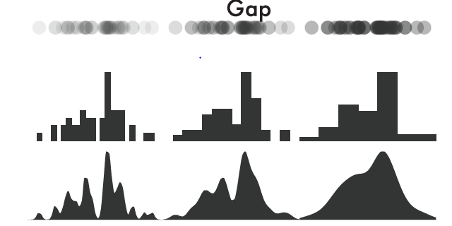
GAP
Randomly sampled 50+n points from the null distribution, and randomly chose a value uniformly from [Q1,Q3]. We removed the n closest points from this location. This results in an irregularly sized region of missing values somewhere in the middle of the distribution

Slide 12
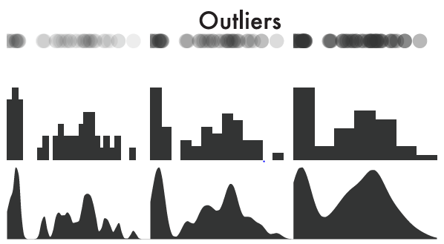
OUTLIERS
We randomly sampled 50−n points from the null distribution. We measured the post-hoc quartiles of these samples. We then placed n points randomly in either the interval [0,Q1 − 1.5*IQR] or [Q3 +1.5*IQR,1], whichever was further from the original sample mean. This results in a “clump” of extreme values on one end of the distribution.
IQR is interquartile range

Slide 13
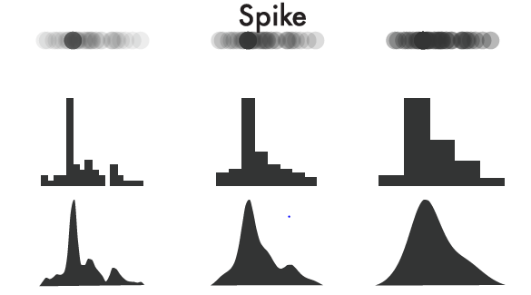
SPIKES
We randomly sampled 50−n points from the null distribution. We measured the post-hoc quartiles of the samples, and randomly chose a value uniformly from [Q1,Q3]. We added n points with exactly this value to the sample. This results in a “spiky” mode somewhere in the middle of the distribution.

Slide 14
VALIDITY

Slide 15

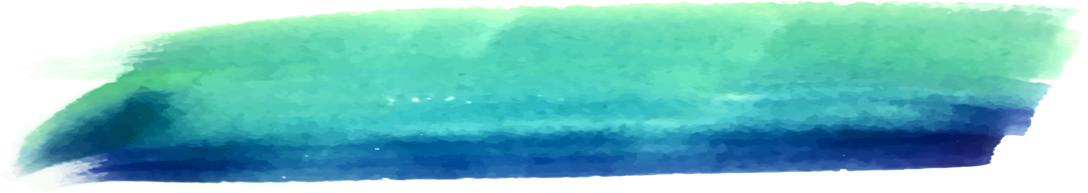
Validity
selected 50 points as data size as a tradeoff between sampling variability and the legibility of individual samples
For each trial, the participants were informed of the precise type of flaw they were meant to detect.
Created histogram with {7, 14, 28} bins.
Created density plot with {0.07, 0.035, 0.0175} bandwidths.
Created dot plots with opacities of {0.35, 0.175, 0.0875}
Recruited 32 participants from prolific.ac
Created 20 visualizations of each type. Only one is flawed among 20.

Slide 16
RESULTS

Slide 17
DETECTION
Across all conditions, participant accuracy was 48.6%
Spikes were easiest to detect with an accuracy of 58.8%
Outliers is second with accuracy of 48.6%
Gaps are hardest to detect with 38.6% accuracy.

Slide 18
VIZUALIZATION PERFORMANCE
Density plots are most accurate with 56.8%
Dot plots are accurate with 48.3%
Histogram is least accurate with 40.9%

Slide 19
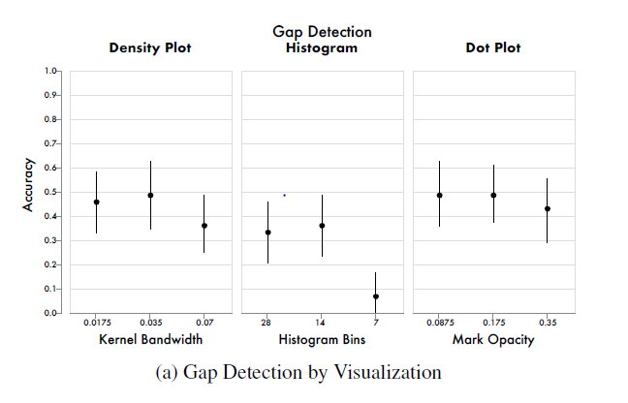
PARAMETER SETTING

Slide 20
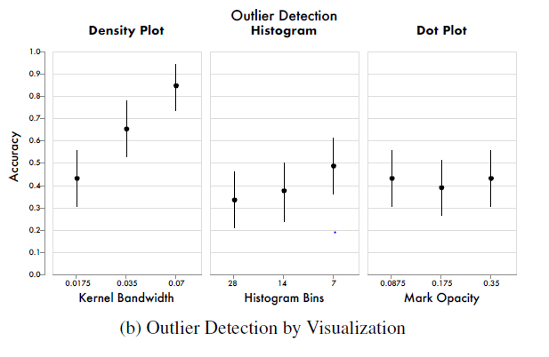
PARAMETER SETTING

Slide 21
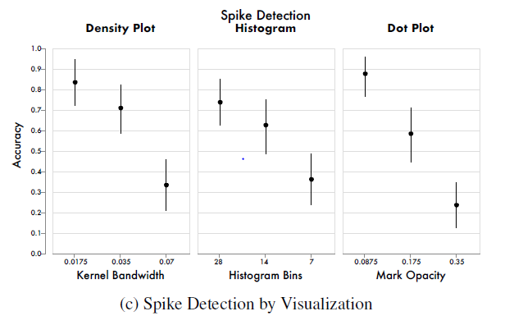
PARAMETER SETTING

Slide 22
CONCLUSION

Slide 23
CONCLUSION
No one visualization would dominate for all flaw types.
More liberal parameter settings will result in increased accuracy.
As the number of flawed points increased, accuracy will increased.

Slide 24
Thanks!
Any questions?

